Slide 1
Introduction to Data Science
What is Data Science, its Lifecycle, and Real-world Applications

Slide 2
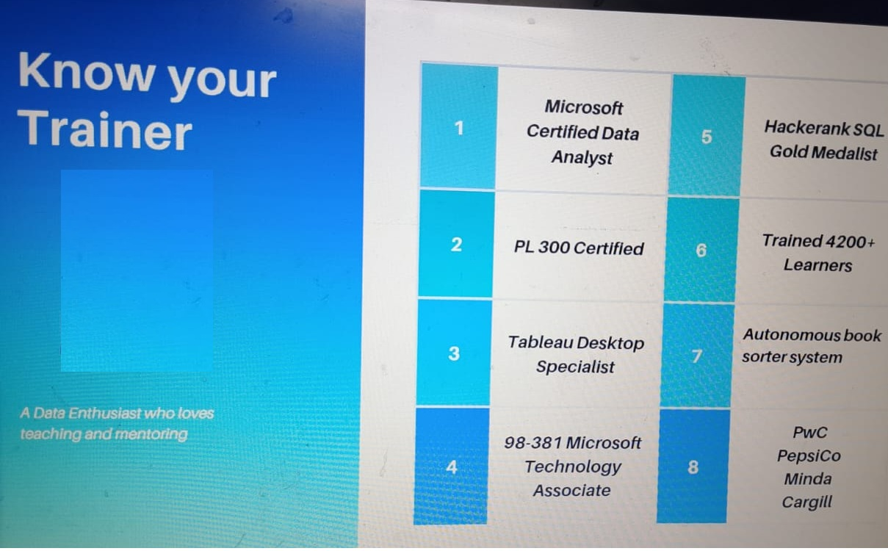

Himanshu Sardana

Slide 3
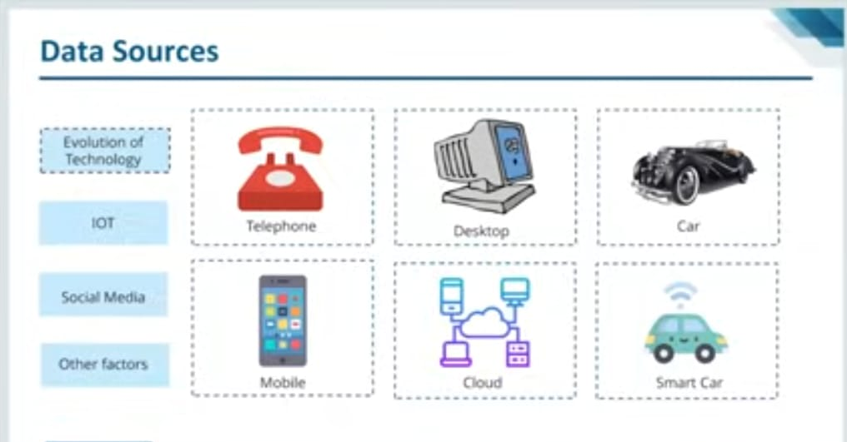

Slide 4
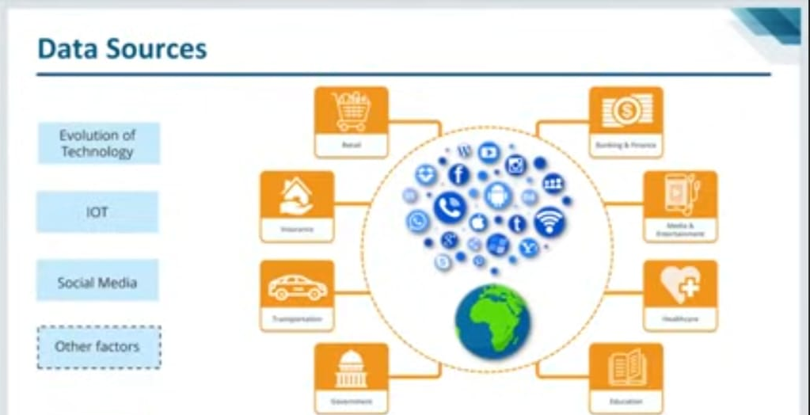

Slide 5
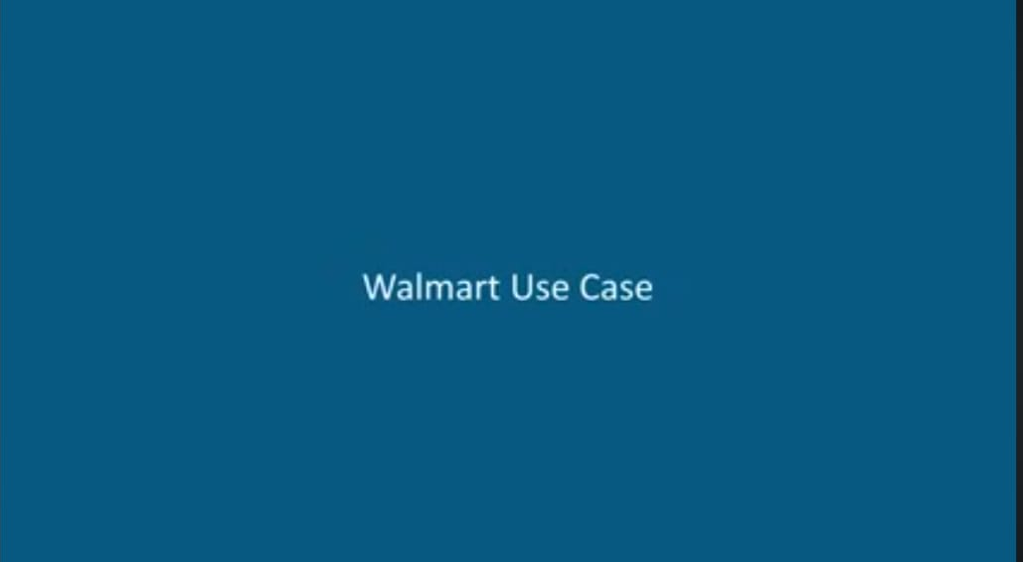

Slide 6
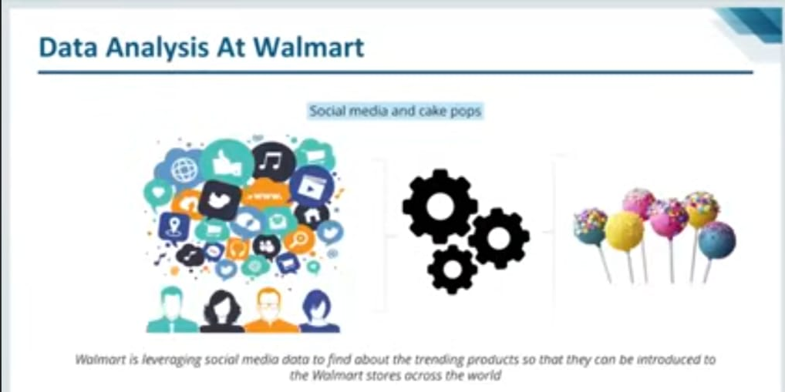

Slide 7
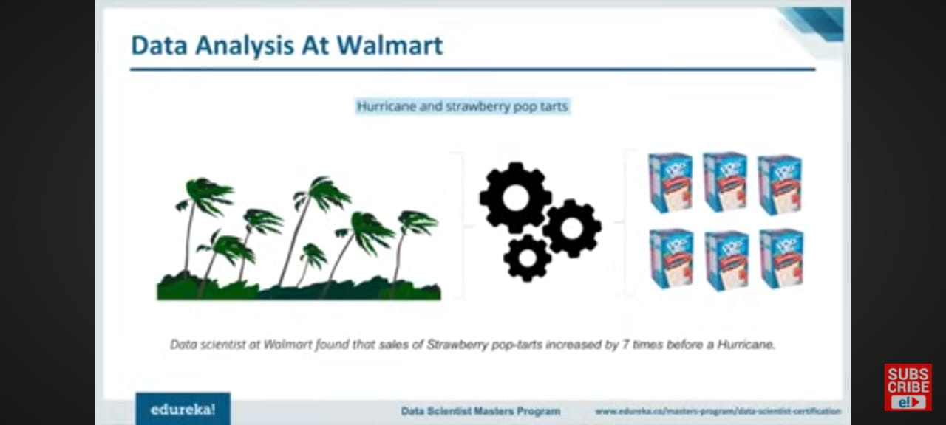

Slide 8


Slide 9
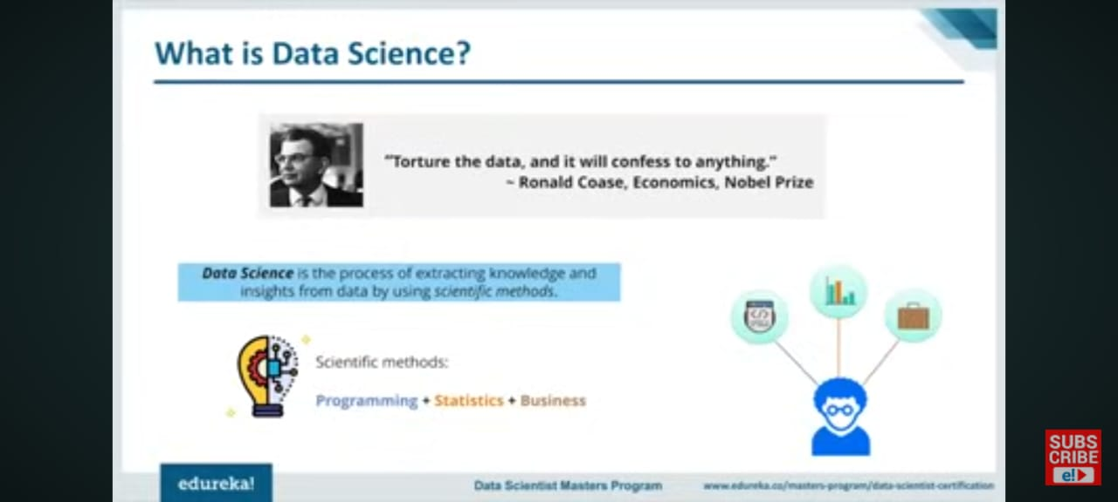

Slide 10
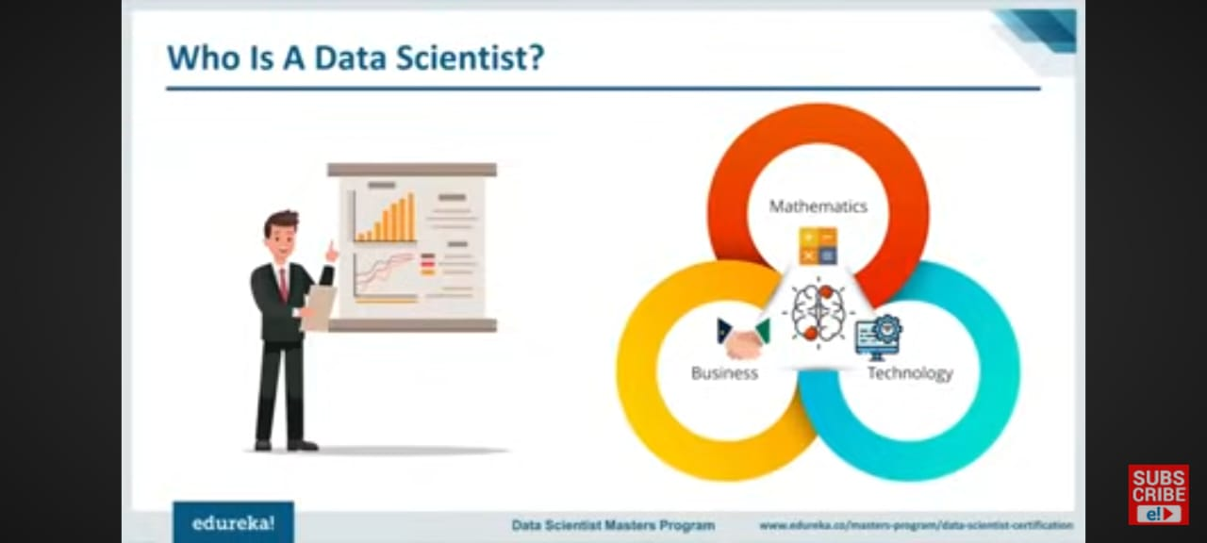

Slide 11
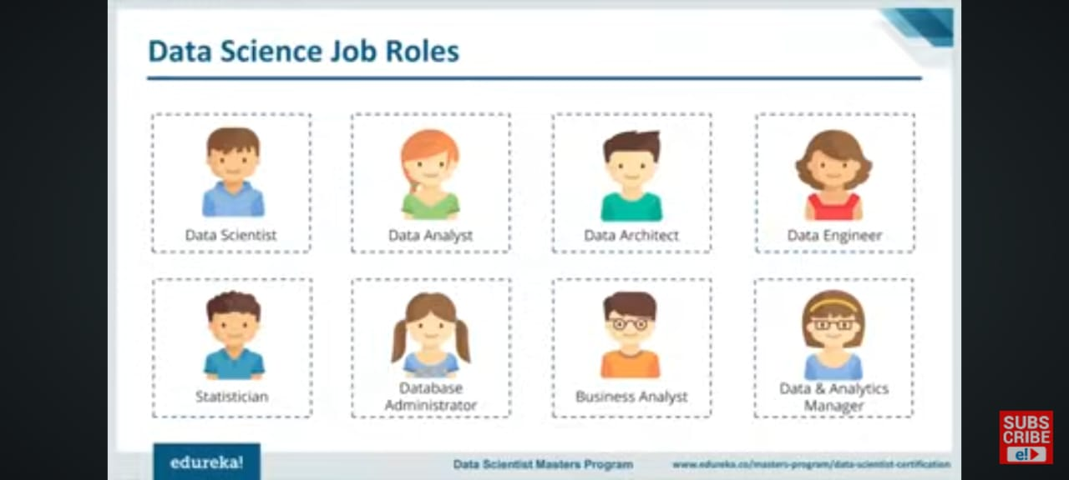

Slide 12
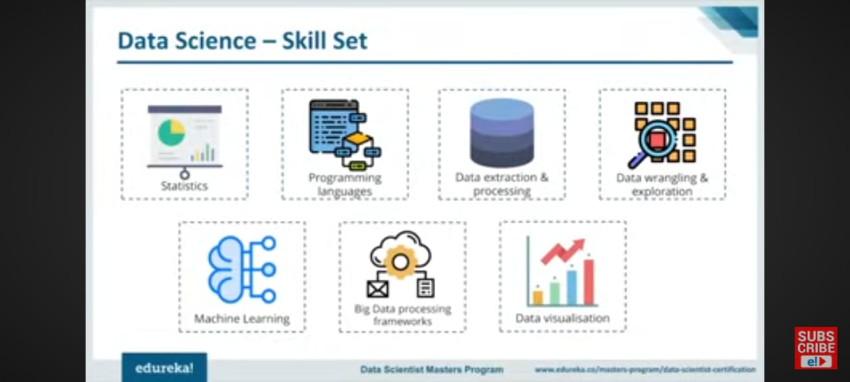

Slide 13
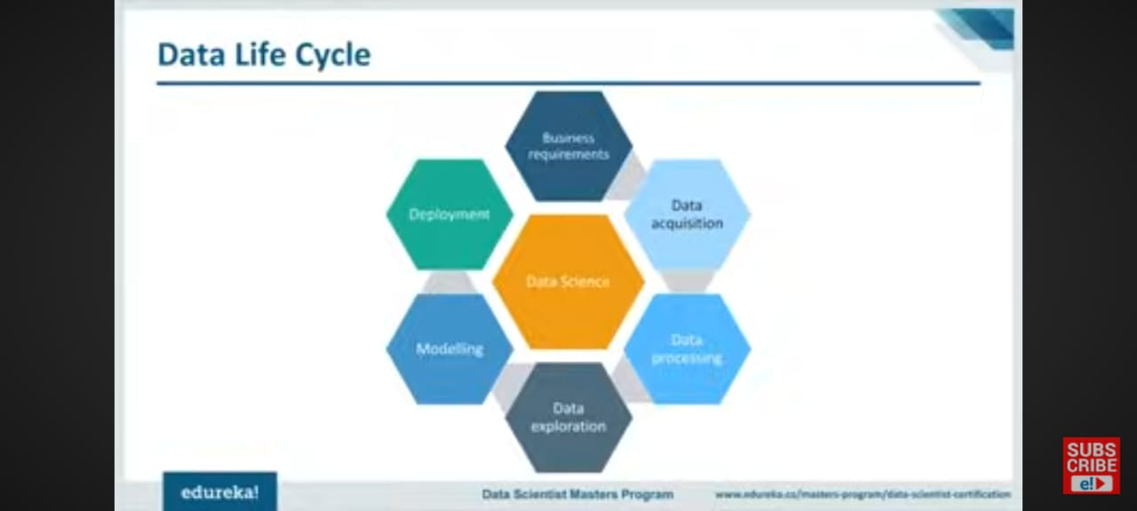

Slide 14
What is Data Science?
• Data Science is an interdisciplinary field focused on extracting knowledge from data.
• Combines statistics, computer science, and domain expertise.
• Uses techniques such as data mining, machine learning, and big data analytics.

Slide 15
Data Science Lifecycle
1. Problem Definition
2. Data Collection
3. Data Cleaning
4. Data Exploration & Visualization
5. Feature Engineering
6. Model Building
7. Model Evaluation
8. Deployment
9. Monitoring & Maintenance

Slide 16
Real-world Applications of Data Science
• Healthcare: Disease diagnosis, personalized treatment.
• Finance: Credit scoring, fraud detection.
• Marketing: Customer segmentation, recommendation systems.
• Retail: Inventory management, demand forecasting.
• Transportation: Route optimization, autonomous driving.

